Slide 1
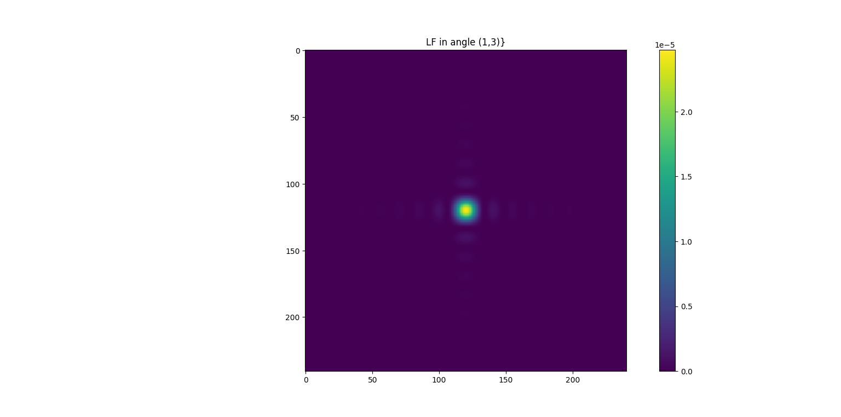
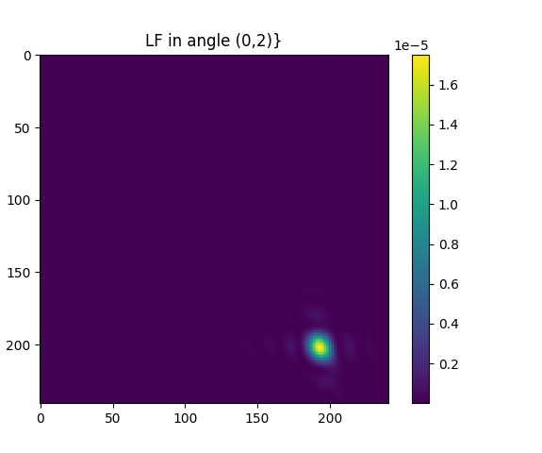
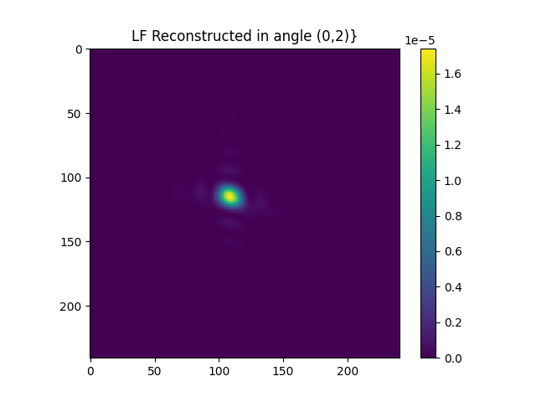
Comparing for a single angle
Without Phase Mask (1,3)
With pure phase mask (0,2)
Forward Reconstruction (0,2)

Slide 2
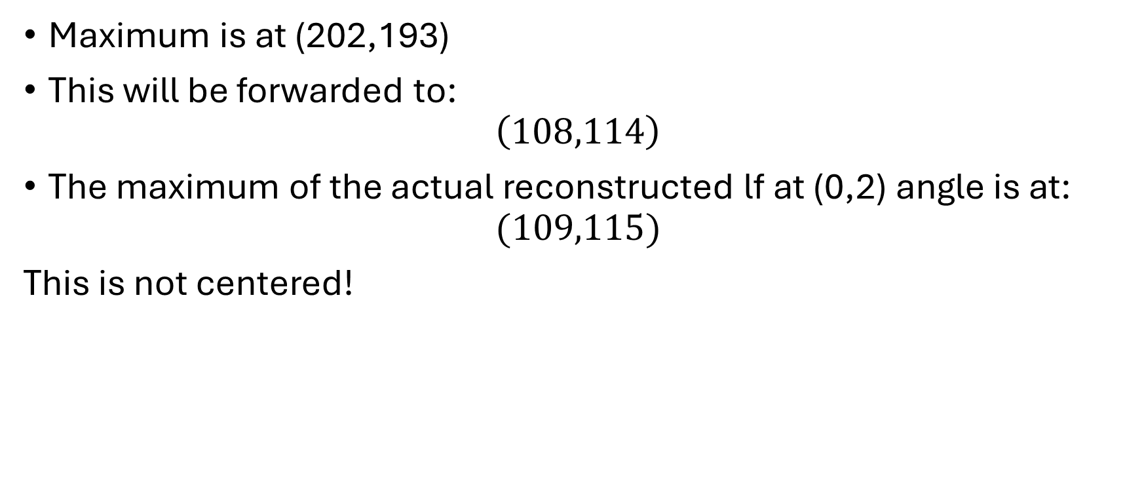
Theoretical Calculation
Maximum is at (202,193)
This will be forwarded to:
$$\left(108,114\right)$$
The maximum of the actual reconstructed lf at (0,2) angle is at:
$$(109,115)$$
This is not centered!

Slide 3
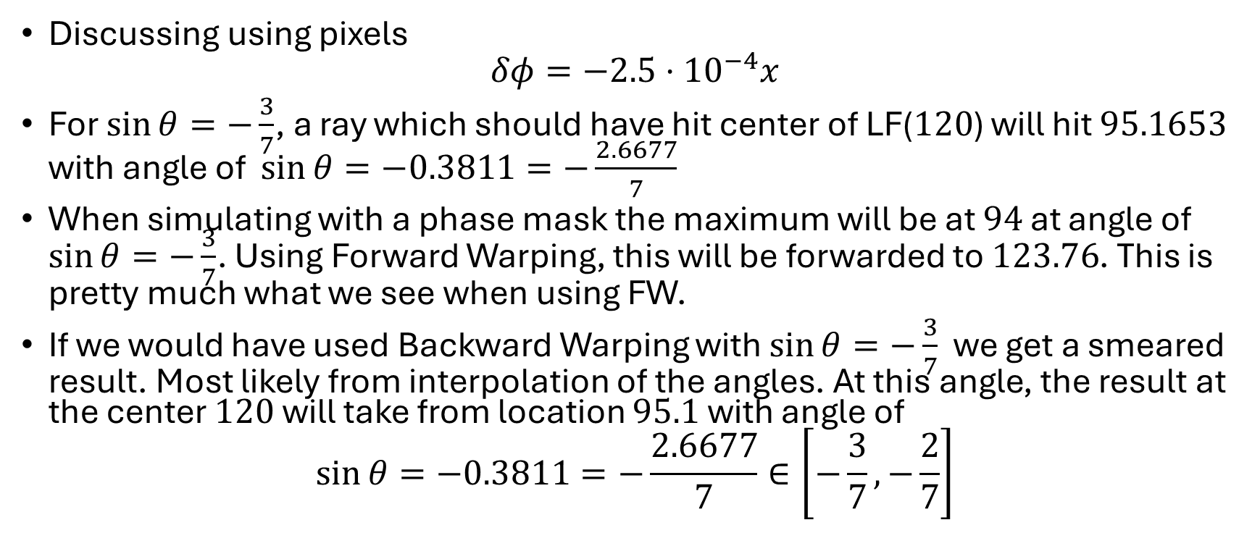
Parabolic phase as a case study
Discussing using pixels
$$δφ=−2.5⋅{10}^{−4}x$$
For $\sin{θ}=−\frac{3}{7}$, a ray which should have hit center of LF($120$) will hit $95.1653$ with angle of $\sin{θ}=−0.3811=−\frac{2.6677}{7}$
When simulating with a phase mask the maximum will be at $94$ at angle of $\sin{θ}=−\frac{3}{7}$. Using Forward Warping, this will be forwarded to $123.76$. This is pretty much what we see when using FW.
If we would have used Backward Warping with $\sin{θ}=−\frac{3}{7}$ we get a smeared result. Most likely from interpolation of the angles. At this angle, the result at the center $120$ will take from location $95.1$ with angle of
$$\sin{θ}=−0.3811=−\frac{2.6677}{7}∈\left[−\frac{3}{7},−\frac{2}{7}\right]$$

Slide 4
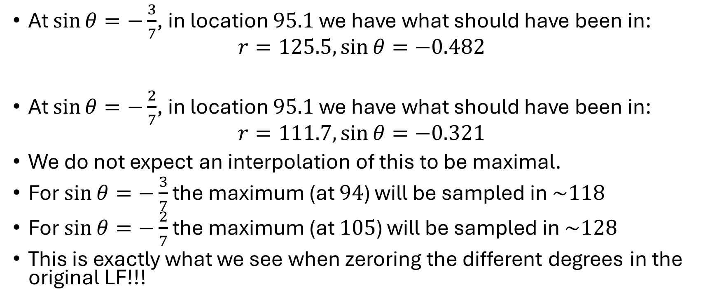
Parabolic phase as a case study
At $\sin{θ}=−\frac{3}{7}$, in location $95.1$ we have what should have been in:
$$r=125.5,\sin{θ=−0.482}$$
At $\sin{θ}=−\frac{2}{7}$, in location $95.1$ we have what should have been in:
$$r=111.7,\sin{θ=−0.321}$$
We do not expect an interpolation of this to be maximal.
For $\sin{θ}=−\frac{3}{7}$ the maximum (at $94$) will be sampled in $\sim 118$
For $\sin{θ}=−\frac{2}{7}$ the maximum (at $105$) will be sampled in $\sim 128$
This is exactly what we see when zeroring the different degrees in the original LF!!!

Slide 5
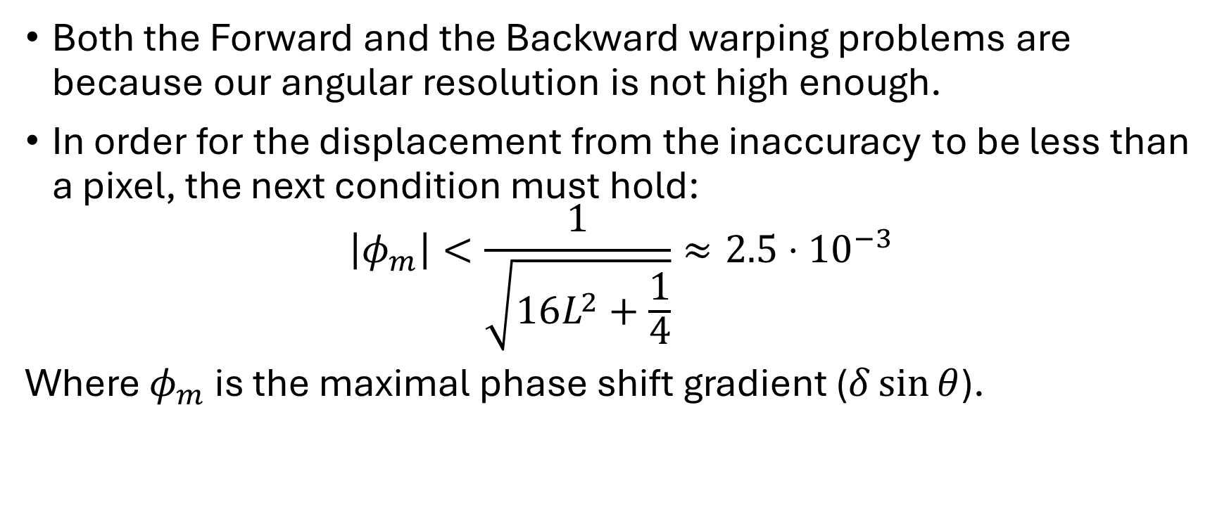
Parabolic phase as a case study
Both the Forward and the Backward warping problems are because our angular resolution is not high enough.
In order for the displacement from the inaccuracy to be less than a pixel, the next condition must hold:
$$\left|φ_{m}\right|<\frac{1}{\sqrt{16L^{2}+\frac{1}{4}}}≈2.5⋅{10}^{−3}$$
Where $φ_{m}$ is the maximal phase shift gradient ($δ\sin{θ}$).

Slide 6
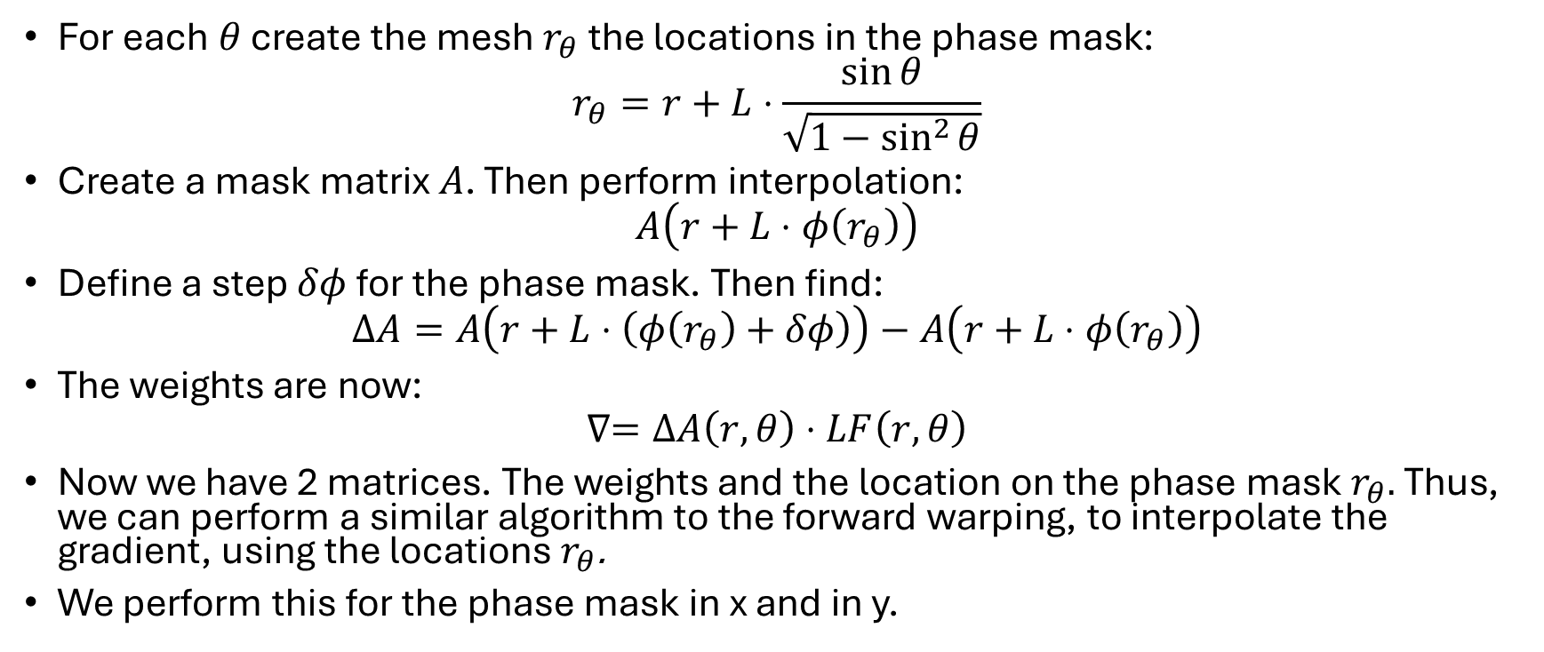
Phase mask algorithm
For each $θ$ create the mesh $r_{θ}$ the locations in the phase mask:
$$r_{θ}=r+L⋅\frac{\sin{θ}}{\sqrt{1−\sin^{2}{θ}}}$$
Create a mask matrix $A$. Then perform interpolation:
$$A\left(r+L⋅φ\left(r_{θ}\right)\right)$$
Define a step $δφ$ for the phase mask. Then find:
$$ΔA=A\left(r+L⋅\left(φ\left(r_{θ}\right)+δφ\right)\right)−A\left(r+L⋅φ\left(r_{θ}\right)\right)$$
The weights are now:
$$∇=ΔA\left(r,θ\right)⋅LF\left(r,θ\right)$$
Now we have 2 matrices. The weights and the location on the phase mask$r_{θ}.$Thus, we can perform a similar algorithm to the forward warping, to interpolate the gradient, using the locations$r_{θ}$.
We perform this for the phase mask in x and in y.

Slide 7


Phase mask(x/y)
$$r_{θ}$$
LF($θ$)
Mask
$$A\left(r+L⋅φ\left(r_{θ}\right)\right)$$
Weights

Slide 8


Phase mask Gradient(x/y)
$$r_{θ}$$
Weights($θ$)

Slide 9
Problems/Questions
There will be holes in the phase mask
Initial main pulse outside of mask will have a very weak gradient
Random initial phase mask?

